Slide 1
JAN’26 - Ralph loops and AGI
State of the art in AI SWE, and what is to come.
Liam Zebedee - @liamzebedee - liamzebedee.com

Slide 2
How to do SWE
Write idea.md
Link the ralph/ directory
Generate specs
Generate plans
Run loop

Slide 3
What’s the fastest way to generate value?
L1 - manual labour: Right now - team of engineers. Write code.
L2.1 - augmented labour: The engineers use some autocompletion AI. Cursor, Claude, ChatGPT, whatever. They merge PR’s, etc.
L3 - delegated labour: The engineers utilise agents to build features. They orchestrate and supervise the agents.
L4 - founder mode orchestration. The engineers build their own companies in code. Agents that supervise other agents, loops that self-improve and iterate.
L5 - extended imagination. You don’t even tell AI’s to do things. You just imagine ideas which are live transcribed into an Apple Note, and like 100 AI’s analyse what you’re saying, spec it, work and build 1,000,000 prototypes, which are progressively refined while you’re talking. The AI is just an extension of your imagination.

Slide 4
What’s the bottleneck?
Level | Gist | SOTA | Innovation | Unlock | New bottleneck
L1 - manual labour | Humans type code | AI doesn’t exist (2022) | Assistant (ChatGPT) | AI can generate code solutions | How fast can I copy-paste from ChatGPT
L2 - augmented labour | Humans generate code, copy-paste | ChatGPT (2022) | Context (Copilot) | AI gets context, autocompletes you | How fast can I tab autocomplete based on features I’m building
 | Humans autocomplete code | Copilot | Tool usage (Claude Code) | AI can navigate codebase, edit/compile/commit | How fast can I build features by instructing Claude agents
 | Humans manage 7 agents (terminal tabs) | Claude Code | Build loop (Ralph) | AI can build on autopilot | How quickly can I write markdown specs?
YOU ARE HERE | Humans write specs, build loop works while you sleep | ? | ? | - | -

Slide 5

What’s a Ralph loop?
Continuously drive the current state (src/) towards the desired state (specs/).
Idea -> Specifications -> Plan -> Loop(Build)

Slide 6
Ralph Loop - idea.md
$ nano idea.md
a presentation to the ausbuildors about this new thing I’ve been learning - ralph loops - and about AI in general
[Pasted 20,000 lines from github.com/ralph/main-repo/README.md]
[Pasted 10,000 lines from stevejobs.com/the-art-of-presenting]
[Pasted 40 tweets from ausbuildors twitter]
[Pasted 40 tweets from the art of the deal by accident]

Slide 7


Ralph Loop - idea.md
$ claude
@PROMPT_reqs.md @idea.md
Thinking…
> wrote specs/presentation.md
> wrote specs/substance.md

Slide 8
Ralph Loop - specs/presentation.md
The presentation is going to be engaging, funny, visual.
Requirements:
* In English
* Between 20-50 slides. Short and concise.
* Fast-paced, engaging, 15mins max.
Anti-requirements:
* SFW, politically correct in any way

Slide 9
Ralph Loop - specs/substance.md
We are going to make a presentation about a new concept - software engineering and Ralph loops.
## Background ### Ralph loops ### SWE processes
## Requirements
* Explain the core ideas
* Ensure explanation has a beat to it, with metaphors, engaging outtakes.
* Ensure technical realism.

Slide 10
Ralph Loop - plan.md
$ claude
@PROMPT_plan.md
Thinking…
> wrote plan.md

Slide 11
Ralph Loop - plan.md
## Stage 1: Ideation
[ ] Take 12 dexies [ ] Turn on video recorder, start drooling as I recount AI tactics for B2B SaaS [ ] Transcribe notes into bullet points [ ] Synthesise slide deck structure from bullets
## Stage 2: Slides
[ ] Create each slide [ ] Add graphics [ ] Add colour to help visuals [ ] Edit and review
## Stage 3: Presentation
[ ] Sleep well [ ] Get a beer [ ] Present

Slide 12
Ralph Loop - plan.md
$ ./ralph/loop.sh

Slide 13
Ralph Loop - plan.md
$ ./ralph/loop.sh
> Iteration 1 > Done
> Iteration 2 > Done
> Iteration 3 > Done

Slide 14
Ralph Loop - plan.md
## Stage 1: Ideation
[x] Take 12 dexies [x] Turn on video recorder, start drooling as I recount AI tactics for B2B SaaS [x] Transcribe notes into bullet points [x] Synthesise slide deck structure from bullets
## Stage 2: Slides
[ ] Create each slide [ ] Add graphics [ ] Add colour to help visuals [ ] Edit and review
## Stage 3: Presentation
[ ] Sleep well [ ] Get a beer [ ] Present

Slide 15
Ralph Loop - plan.md
$ ./ralph/loop.sh
> Iteration 1 > Done
> Iteration 2 > Done
> Iteration 3 > Done

Slide 16
Ralph Loop - plan.md
## Stage 1: Ideation
[x] Take 12 dexies [x] Turn on video recorder, start drooling as I recount AI tactics for B2B SaaS [x] Transcribe notes into bullet points [x] Synthesise slide deck structure from bullets
## Stage 2: Slides
[x] Create each slide [x] Add graphics [x] Add colour to help visuals [x] Edit and review
## Stage 3: Presentation
[ ] Sleep well [ ] Get a beer [ ] Present

Slide 17
Ralph Loop - plan.md
$ ./ralph/loop.sh
> Iteration 1 > Done
> Iteration 2 > Done
> Iteration 3 > Done

Slide 18
Ralph Loop - plan.md
## Stage 1: Ideation
[x] Take 12 dexies [x] Turn on video recorder, start drooling as I recount AI tactics for B2B SaaS [x] Transcribe notes into bullet points [x] Synthesise slide deck structure from bullets
## Stage 2: Slides
[x] Create each slide [x] Add graphics [x] Add colour to help visuals [x] Edit and review
## Stage 3: Presentation
[x] Sleep well [x] Get a beer [x] Present

Slide 19
Ralph Loop - loop.sh
while(true): claude < PROMPT_loop-build.md

Slide 20
Ralph Loop - PROMPT_loop-build.md
0a. Read specs. 0b. Read plan. 0c. Read code.
Pick one item; search; implement.
Run tests; fix gaps.
Update plan with issues.
Tests pass; commit; push.

Slide 21
What’s a Ralph loop?
loop.sh
PROMPT_loop-build.md
src/
plan.md
specs/
Continuously
drive
current state
towards
desired state

Slide 22
Okay but who fucking cares?
It doesn’t stop there

Slide 23
Ralph Loop - reporting bugs
$ claude
@PROMPT_reportbug.md the homepage isn’t rendering
Thinking…
> wrote bugs/homepage-render-bug.md

Slide 24
Ralph Loop - reporting bugs
$ ./ralph/loop.sh
@PROMPT_reportbug.md the homepage isn’t rendering
Thinking…
> wrote bugs/homepage-render-bug.md

Slide 25
Does the loop only do dev? Can it do other stuff?

Slide 26
A bugfix loop I built.
PROMPT_loop-bugfix.md
Instead of building specifications
Investigate bugs, reproduce them
And fix them

Slide 27
A bugfix loop I built.
loop.sh
PROMPT_loop-bugfix.md
src/
plan.md
bugs/resolved/
Continuously
drive
current state
towards
desired state

Slide 28
Could we loop marketing?
Could the loop make brainrot marketing videos?
Could the loop do marketing? Based on reading the changelog for new features? How would this look?
PROMPT_loop-???.md

Slide 29
A marketing loop for new features.
read the changelog.md
briefs/ = create a tiktok brief for each feature
ideas/ = loop(generate ideas) for each brief
videos/ = generate tiktoks for every idea
schedule and publish tiktoks
measure engagement, store feedback in feedback/
PROMPT_loop-sell-this-pen.md

Slide 30
Okay. And now we humans manually analyse
Okay. And now we humans manually analyse
Okay. And now we humans manually analyse
Okay. And now we humans manually analyse
Okay. And now we humans manually analyse
Okay. And now we humans manually analyse
Okay. And now we humans manually analyse
Okay. And now we humans manually analyse
Okay. And now we humans manually analyse
Okay. And now we humans manually analyse
Okay. And now we humans manually analyse
Okay. And now we humans manually analyse
Okay. And now we humans manually analyse
Okay. And now we humans manually analyse
Okay. And now we humans manually analyse
Okay. And now we humans manually analyse

Slide 31


Okay. And now we humans manually analyse
Okay. And now we humans manually analyse
Okay. And now we humans manually analyse
Okay. And now we humans manually analyse
Okay. And now we humans manually analyse
Okay. And now we humans manually analyse
Okay. And now we humans manually analyse
Okay. And now we humans manually analyse
Okay. And now we humans manually analyse
Okay. And now we humans manually analyse
Okay. And now we humans manually analyse
Okay. And now we humans manually analyse
Okay. And now we humans manually analyse
Okay. And now we humans manually analyse
Okay. And now we humans manually analyse
Okay. And now we humans manually analyse

Slide 32

Okay. And now we humans manually analyse
Okay. And now we humans manually analyse
Okay. And now we humans manually analyse
Okay. And now we humans manually analyse
Okay. And now we humans manually analyse
Okay. And now we humans manually analyse
Okay. And now we humans manually analyse
Okay. And now we humans manually analyse
Okay. And now we humans manually analyse
Okay. And now we humans manually analyse
Okay. And now we humans manually analyse
Okay. And now we humans manually analyse
Okay. And now we humans manually analyse
Okay. And now we humans manually analyse
Okay. And now we humans manually analyse
Okay. And now we humans manually analyse

Slide 33
Uhhhhh…no. We loop the feedback too, dumbass.

Slide 34
Uhhhhh…no. We loop the feedback too, dumbass.
Hey ChatGPT, the marketing video where I intentionally spark rage in my viewers where I talk about <insert-your-contentious-political-current-thing-here> while two OF models I hired jiggle their tits in the backgrounds seems to be doing the numbers on Instagram.
My other one where I talk really boringly about B2B SaaS only got views from my grandma saying “good work”
What could this mean?

Slide 35
Uhhhhh…no. We loop the feedback too, dumbass.
Hey ChatGPT, the marketing video where I intentionally spark rage in my viewers where I talk about <insert-your-contentious-political-current-thing-here> while two OF models I hired jiggle their tits in the backgrounds seems to be doing the numbers on Instagram.
My other one where I talk really boringly about B2B SaaS only got views from my grandma saying “good work”
What could this mean?
> It seems that sex sells and people want to feel angry.
> Adding this to AGENTS.md.

Slide 36
IT’S 2026 PEOPLE

Slide 37
get with
the program

Slide 38
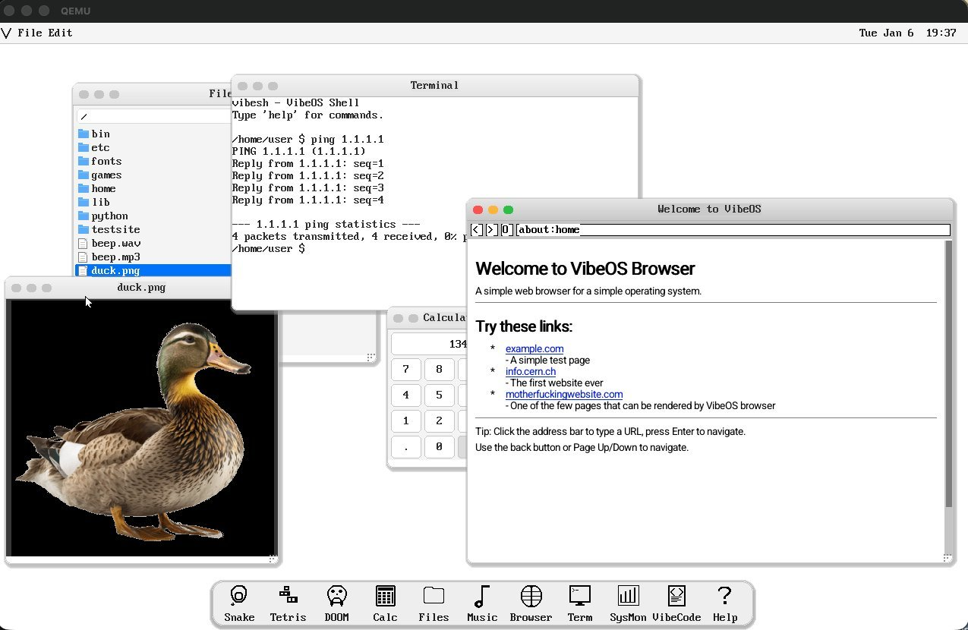
an AI
cloned
an entire OS
from scratch

Slide 39
my computer literally built me a neural network
which taught random geometric shapes how to walk
and then gave some of them roles as predators and others as prey
and gave eyes to each so they could see the other ones
and then trained the predators to chase the prey
and the prey to run away
and all I had to do
was ask it to do that
and sit and steer it for a bit

Slide 40
we live in the motherfucking future
I know how neural networks work
But I never got good at the mathematics or frameworks
It probably doesn’t matter anymore.
I am doing magic on my computer

Slide 41
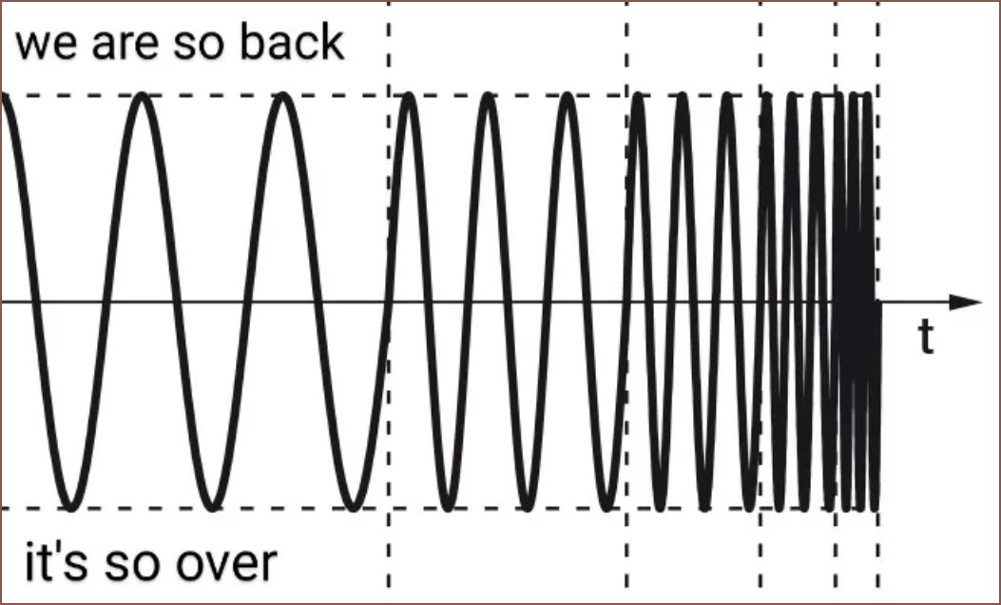
We probably don’t get it at all
I remember writing code by hand 5 years ago
And I played with GPT3.0 (before ChatGPT)
Then 4 years ago - ChatGPT. I copy-pasted some stuff
Then 3 years ago - Copilot. I tabbed some stuff.
Then 2 years ago - o1. I got it to do some complex consensus algorithm implementation.
Then 1 year ago - Claude. I got it to write entire files.
Now today - I go to sleep and when I wake up, my guys have autonomously built me software

Slide 42
Building software autonomously = pouring jet fuel into OpenAI’s tank as Sam Altman smokes his opponents (the past, nonprofit regulations) in his hot gay Lotus (superintelligence)
By the end of this year, we probably will look at today’s capabilities as like “wow, how did I not see this coming”.

Slide 43
Let me give you a metaphor
Sama wanted to raise $7T
That’s the total growth in GDP between 1975 and 1985
10yrs of work
Now imagine how long it took you to build a SaaS app in 2020.
And how long it will take in 2030.
3mo to 3s
That’s 2,629,746x faster
How much money could you make in one year in 2020, if I gave you this thing which did all your work for pennies at 2,500,000x times the speed?

Slide 44
How to do SWE in JAN26
Cultivate judgement as an orchestrator.
The right underlying primitives to use for a problem (prompts, frameworks, skills, technologies).
Context windows, leveraging latent intelligence of models (prompting), agents, harnesses, looping, etc.
Bottleneck
Ideas -> Features -> Requirements -> Plans -> Build loops
Bugs -> Bug tickets -> Plans -> Bug fix loops
Question you should be asking - what’s the next bottleneck?
What can be made parallel?
What’s the best bang-for-buck, in terms of tokens to value delivered? You only have 20M Claude Max tokens per week.
As the build loop is running, another loop is producing specs to build. As the bugfix loop is running, another loop is studying the program interactions and testing it to find bugs. As the “SWE” loop is running, another loop is running to market features on TikTok and Shorts. As the marketing loop is running, another loop is running to study the world, and ideate on new product capabilities. As the new product capabilities loop is running, 3 humans who created this company are reading and talking to a team of AI analysts. The analysts are real-time deep researching ideas as the humans are saying things.
Steering - sitting in Claude Code terminal as it is supervising another loop, you can live type feedback to “steer” the AI.

Slide 45
What’s the bottleneck?
Level | Gist | SOTA | Innovation | Unlock | New bottleneck
L3 - delegated labour YOU ARE HERE | Humans write specs, agent works while you sleep | Ralph (Claude Code) | ? | - | -
…
L4 - founder mode orchestration | Humans design workers, orchestrate workers, provide intent and idea
…
L5 - extended imagination | Humans think of ideas and AI’s shape the world to your imagination

Slide 46
What happens to work?
Wait, AI can work autonomously? Wait, the thing works while I’m asleep? It’s kinda like investing!
Wait, I can make my own agents for different domains?
Wait, I can automate the work of an entire startup (marketing, engineering, sales)?
Wait, I still need to be human-in-the-loop. For how long? Huh, only 6mo? That’s nuts. Wait, can I design another loop to automatically adjust the loop when the next model comes out? FUCKKKK.
Wait, what other roles could AI automate? Could it do policy? Could it do construction? Could it run a farm?
Oh wait, it needs data. Wait, where’s all the data? We need it in one place to make this possible.
Wait, how do I differentiate myself when everyone can do this?
Wait, the cost of agent employees is getting lower, AND at the SAME time, they are getting faster?

Slide 47
What happens to work?
Wait, do I need to write prompts? Can’t I just ask it to “watch and observe”? When is it going to be able to self-learn? Is that hard?
If I can build a SaaS app in 1 day, why is everything else so slow? What actually takes so long?
Wait, you’re telling me the benchmark is now 1 person replaces 20 employees? Last year it was everyone getting 2x faster.
Wait, how come 20% of jobs on seek.com are just data entry specialists for AI models?

Slide 48
What happens to work?
Wait, why does it take 6mo for a policy proposal to be drafted for AU Gov?
Wait, why do we even read the news? Wouldn’t it be faster for an AI to read announcements of new stuff and write the policy before we even know we need it?
Wait, you’re telling me AI’s aren’t actually dumb, it’s that we’re just using them wrong?

Slide 49
What bottlenecks persist?
AI can’t operate in physical world -> Robotics
AI can’t do all of law because the data’s not centralised -> Get the data
AI can’t work on private client data -> Open-source local models
AI can’t do biology -> Automated biolabs
AI can’t operate farms -> Integrate all the sensors, build a loop, sell to farms
AI doesn’t have enough energy
AI doesn’t get enough data -> more sensors being rapidly designed and deployed
Humans can’t translate intent rapidly enough (ie. video game design) -> Build new interfaces

Slide 50
What are the tactics to staying sane?
Take responsibility for problems. I am a problem-solver. Before: I solve problems of there not being code for features. Now: I solve problems of AI agents not having specifications for building features.
Learn the new tools to solve problems. Loops. Supervisors.

Slide 51
What are the tactics to staying sane?
Parse the world through questions. Can the model automate my work? At what point does it stop doing that reliably? And when does that change? Rather than holding onto ideas (“the current capability is this”), hold onto questions. They will allow you to adapt much more easily. Always ask yourself - what is the next bottleneck?
Retain your context window. Things will change faster than you can actually change with them. That’s fine. Just pick a schedule to pickup the SOTA, and stick to it.

